Slide 1

Request for Quotation 190184
Insourcing Solenoid Armature
19.09.2024
A07591000B / Bosch RzP
Contact person Gluth:
Contact person Bosch RzP:
Bernhard Hacker
Technical Sales
E-Mail: hacker.bernhard@gluth.eu
Tel : +49 9421 / 544-19
Mobil : +49 151 / 1402 8680
Fabien Brault
Mechanical Engineering
E-Mail: brault.fabien@gluth.eu
Tel : +49 9421 / 544-78
William Bauguil
Planner
RzP/MFE1
E-Mail: william.bauguil@fr.bosch.com
Tel : +33 5 6567-9485
Mobil : +33 6 34 26 44 81
Sara Gohier
Purchaser
GS/PUI5-TME2
E-Mail: sara.gohier@ro.bosch.com
Tel : +40 722 358 050

Slide 2
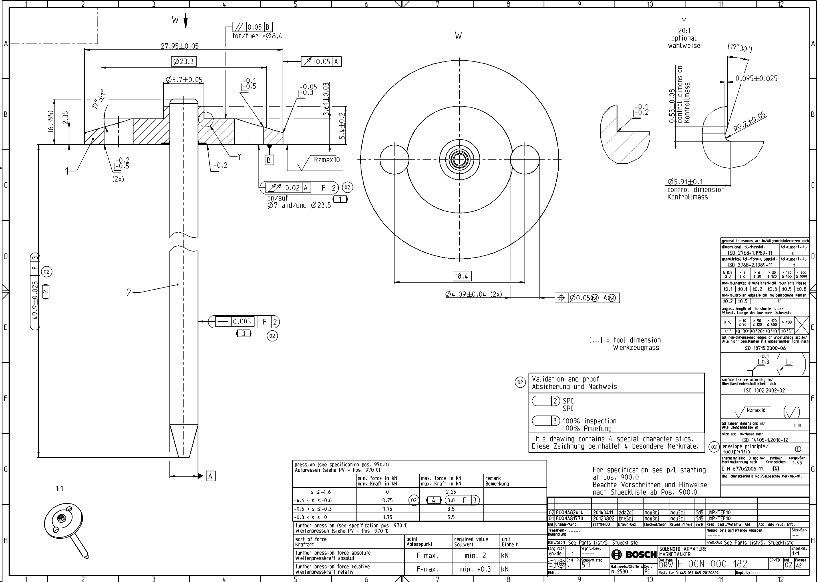
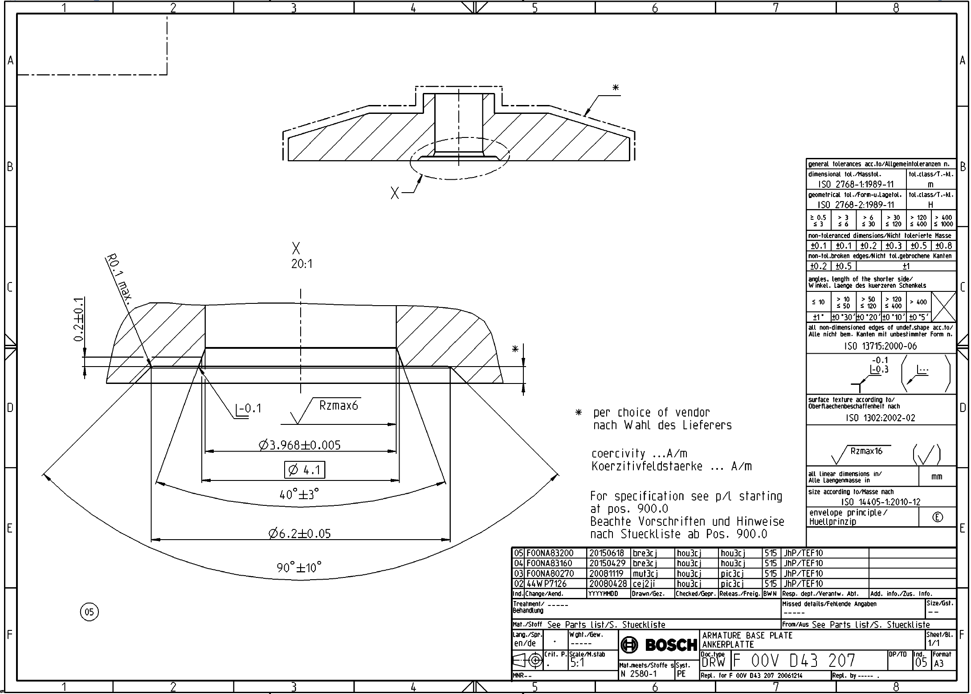
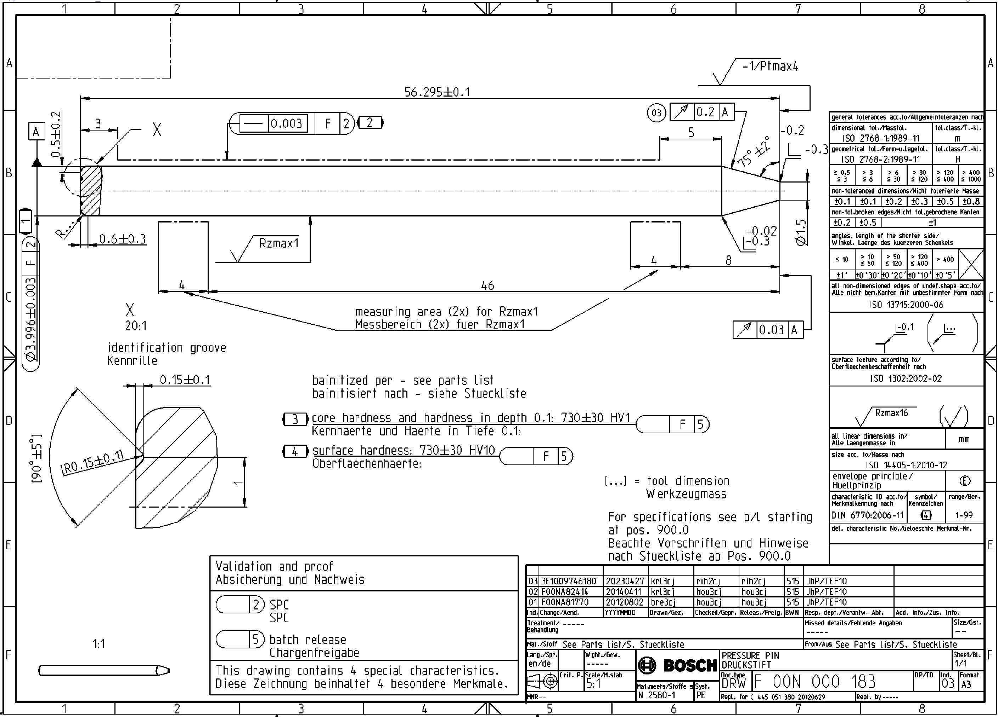
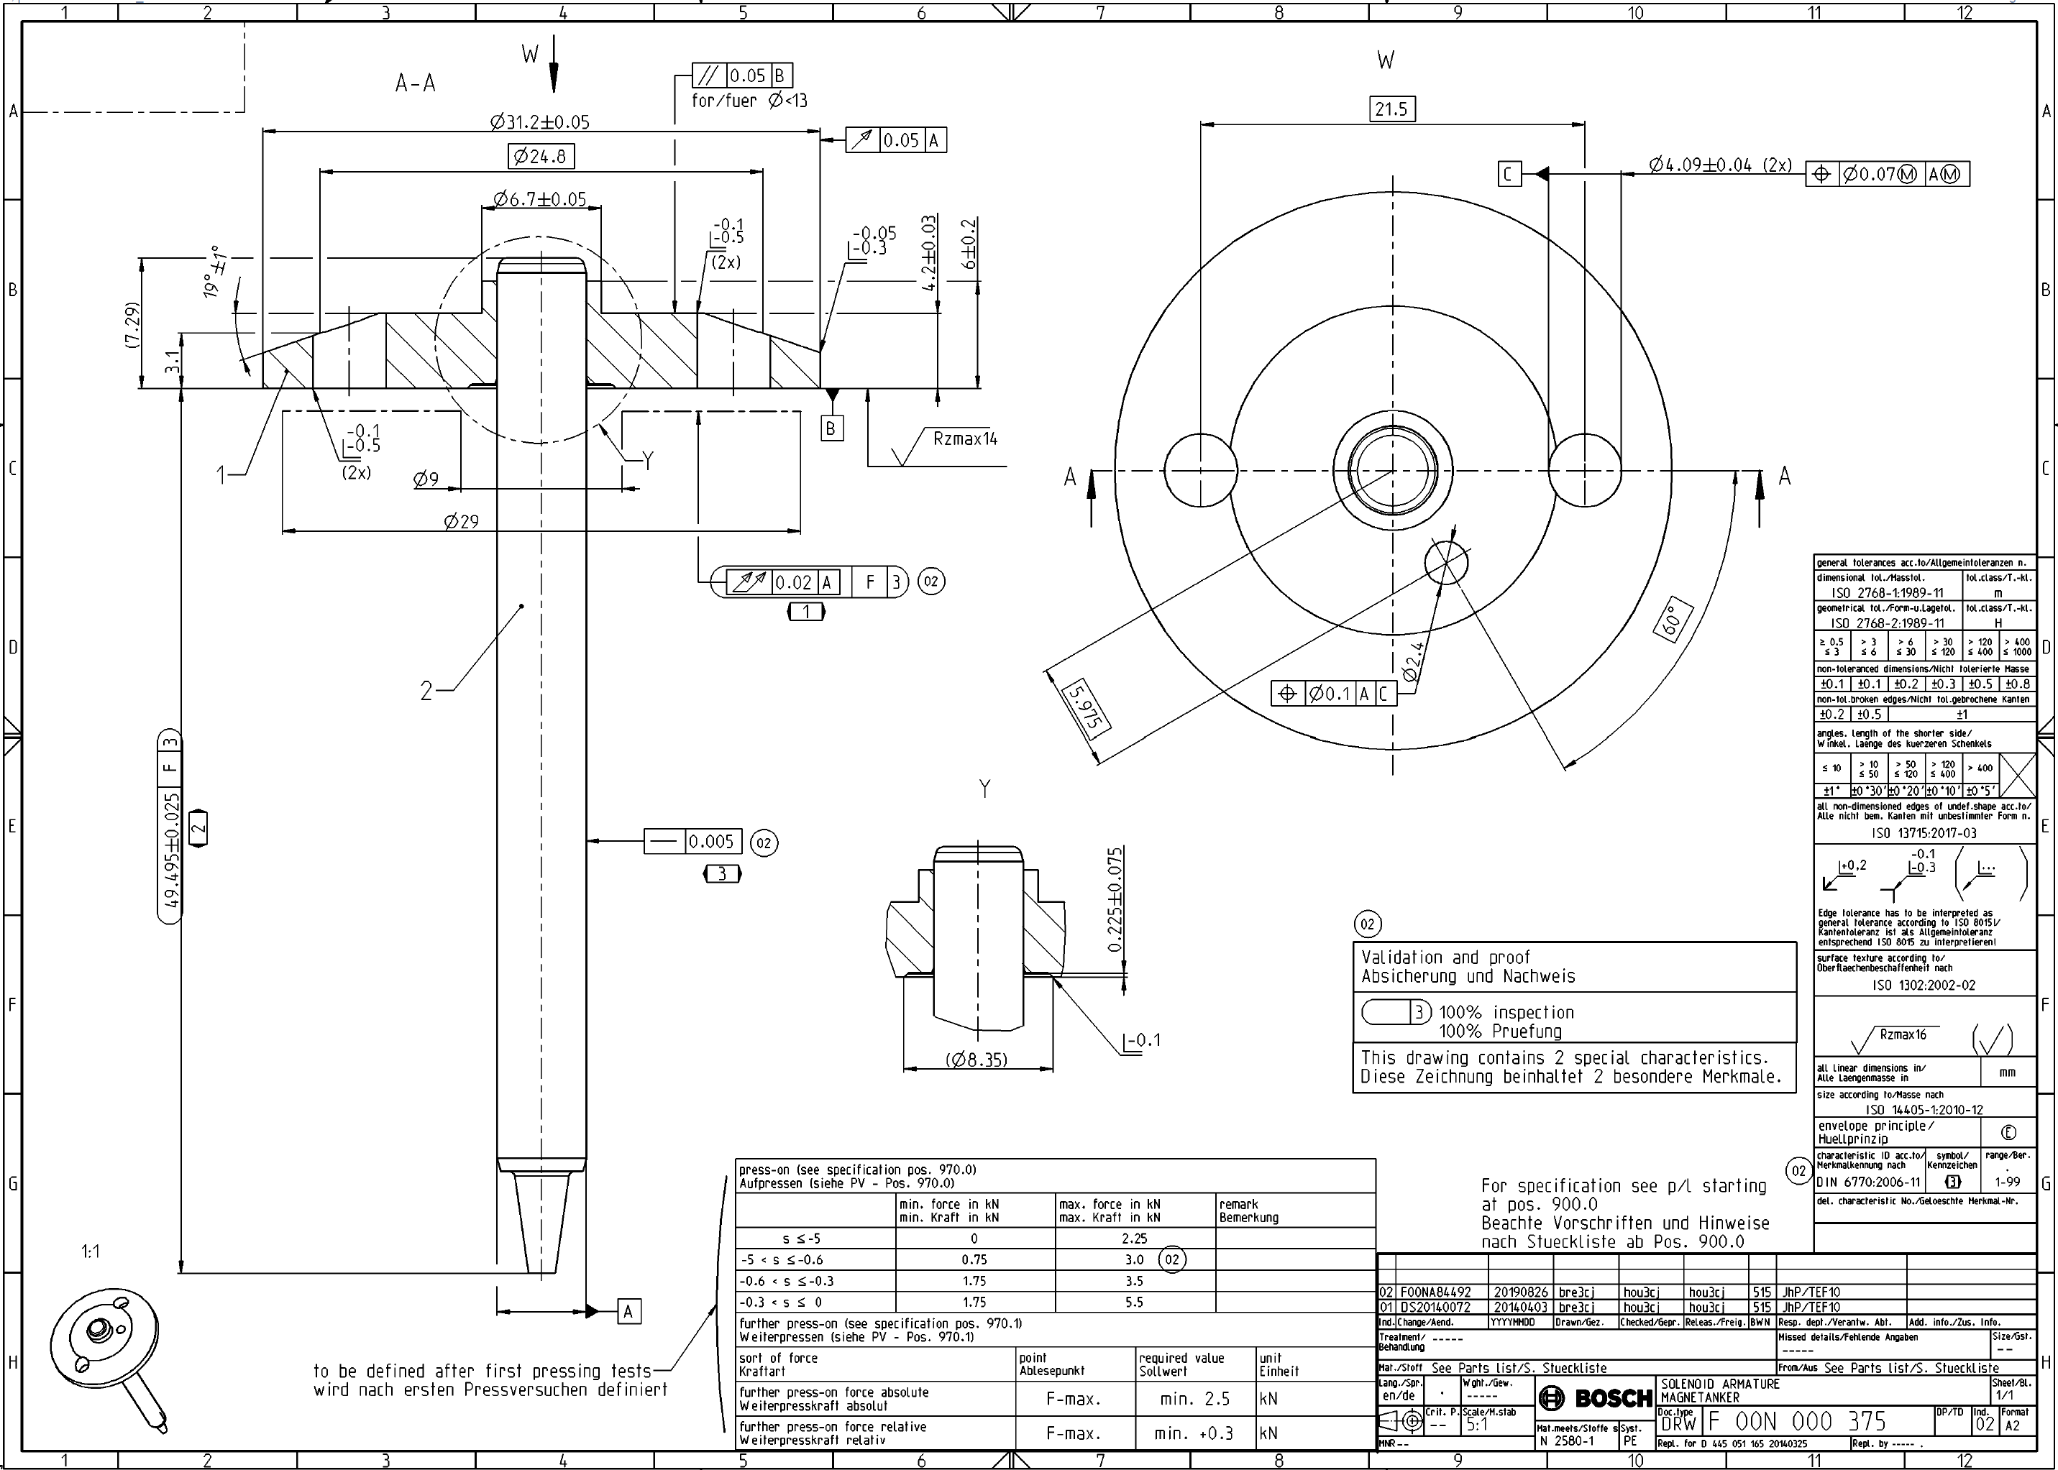
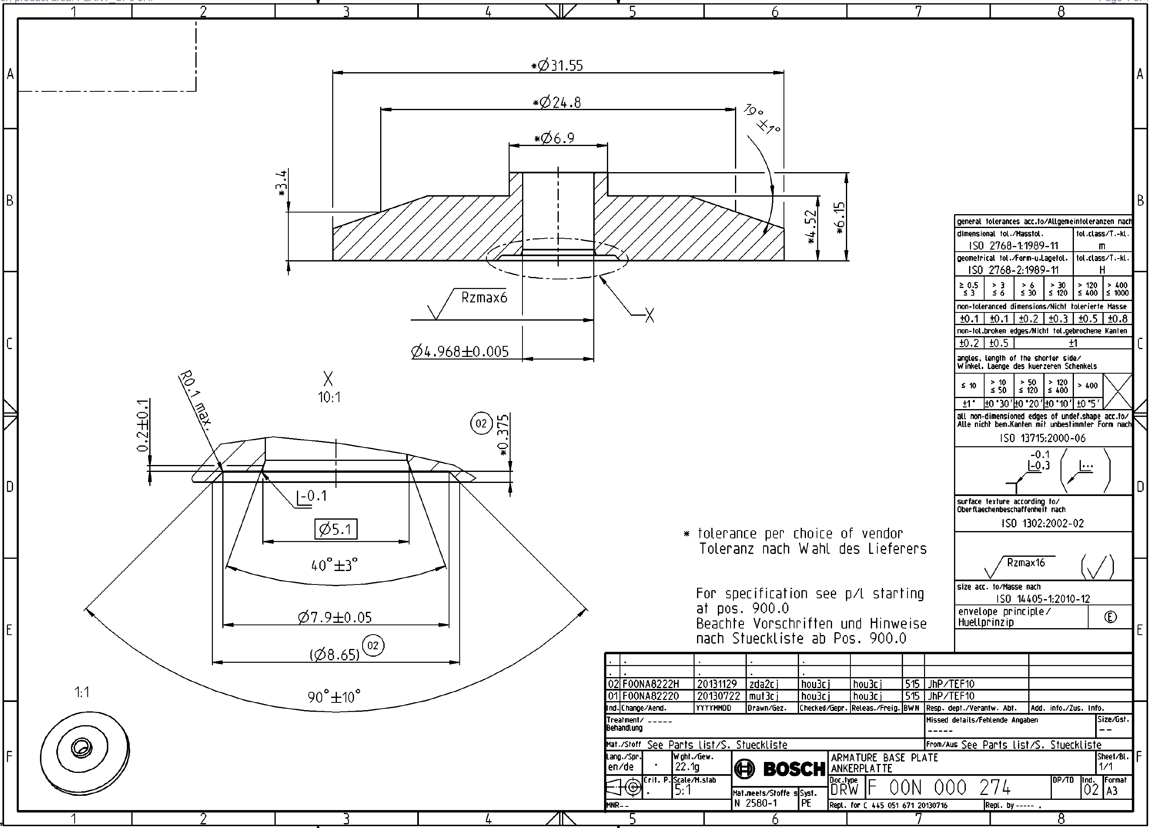
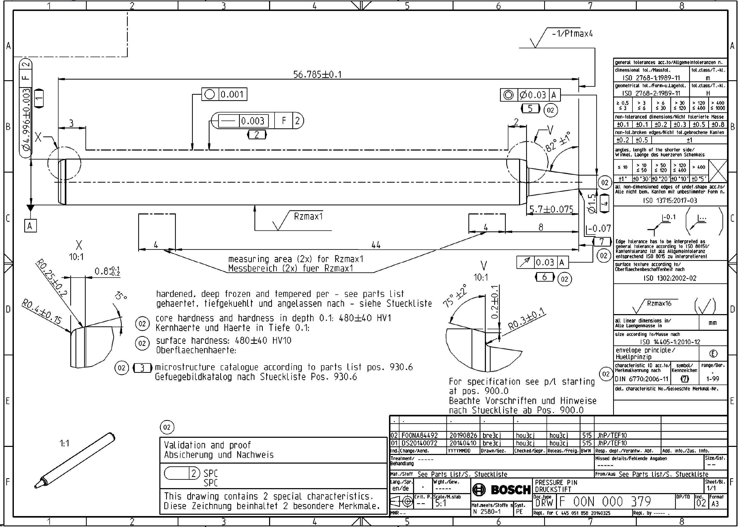
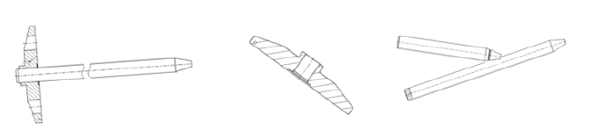
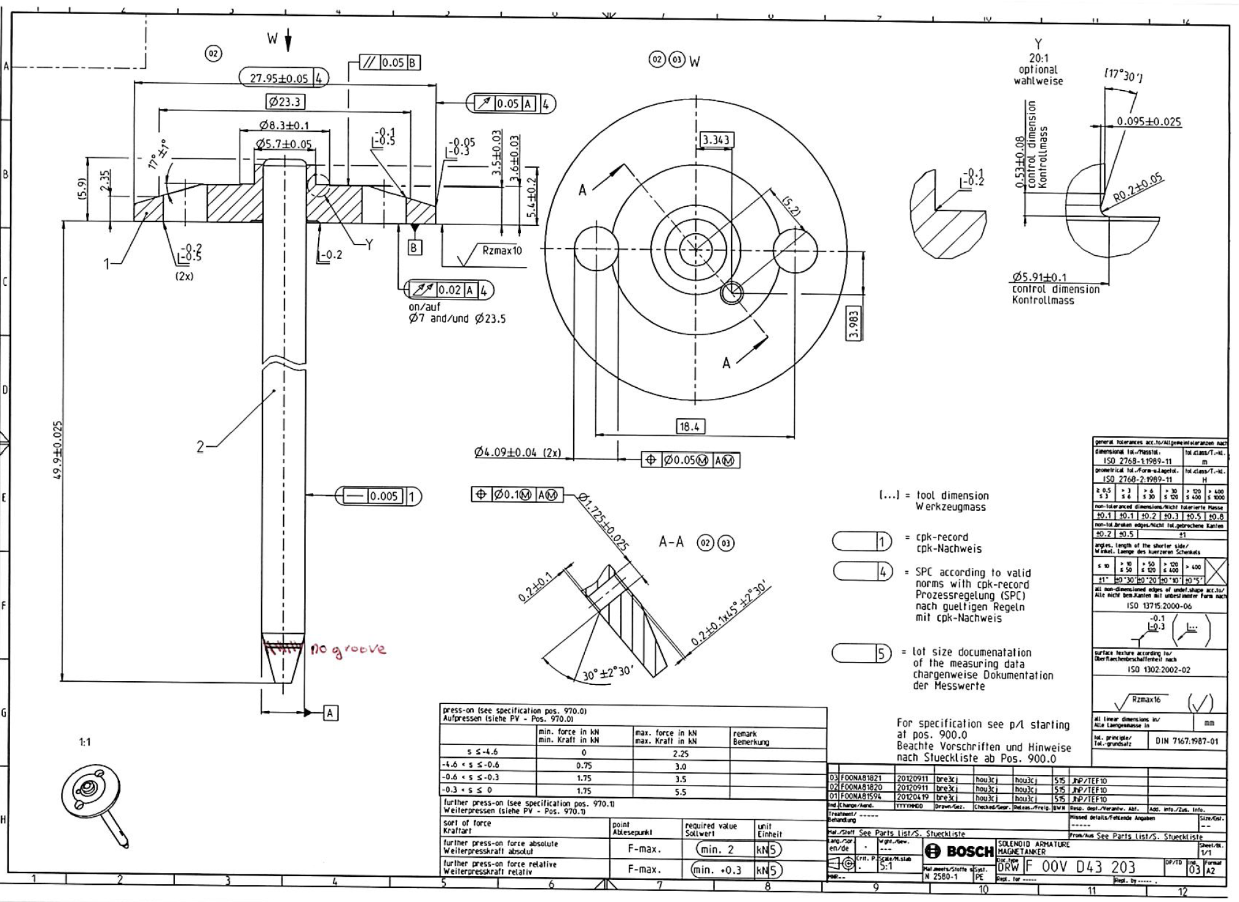
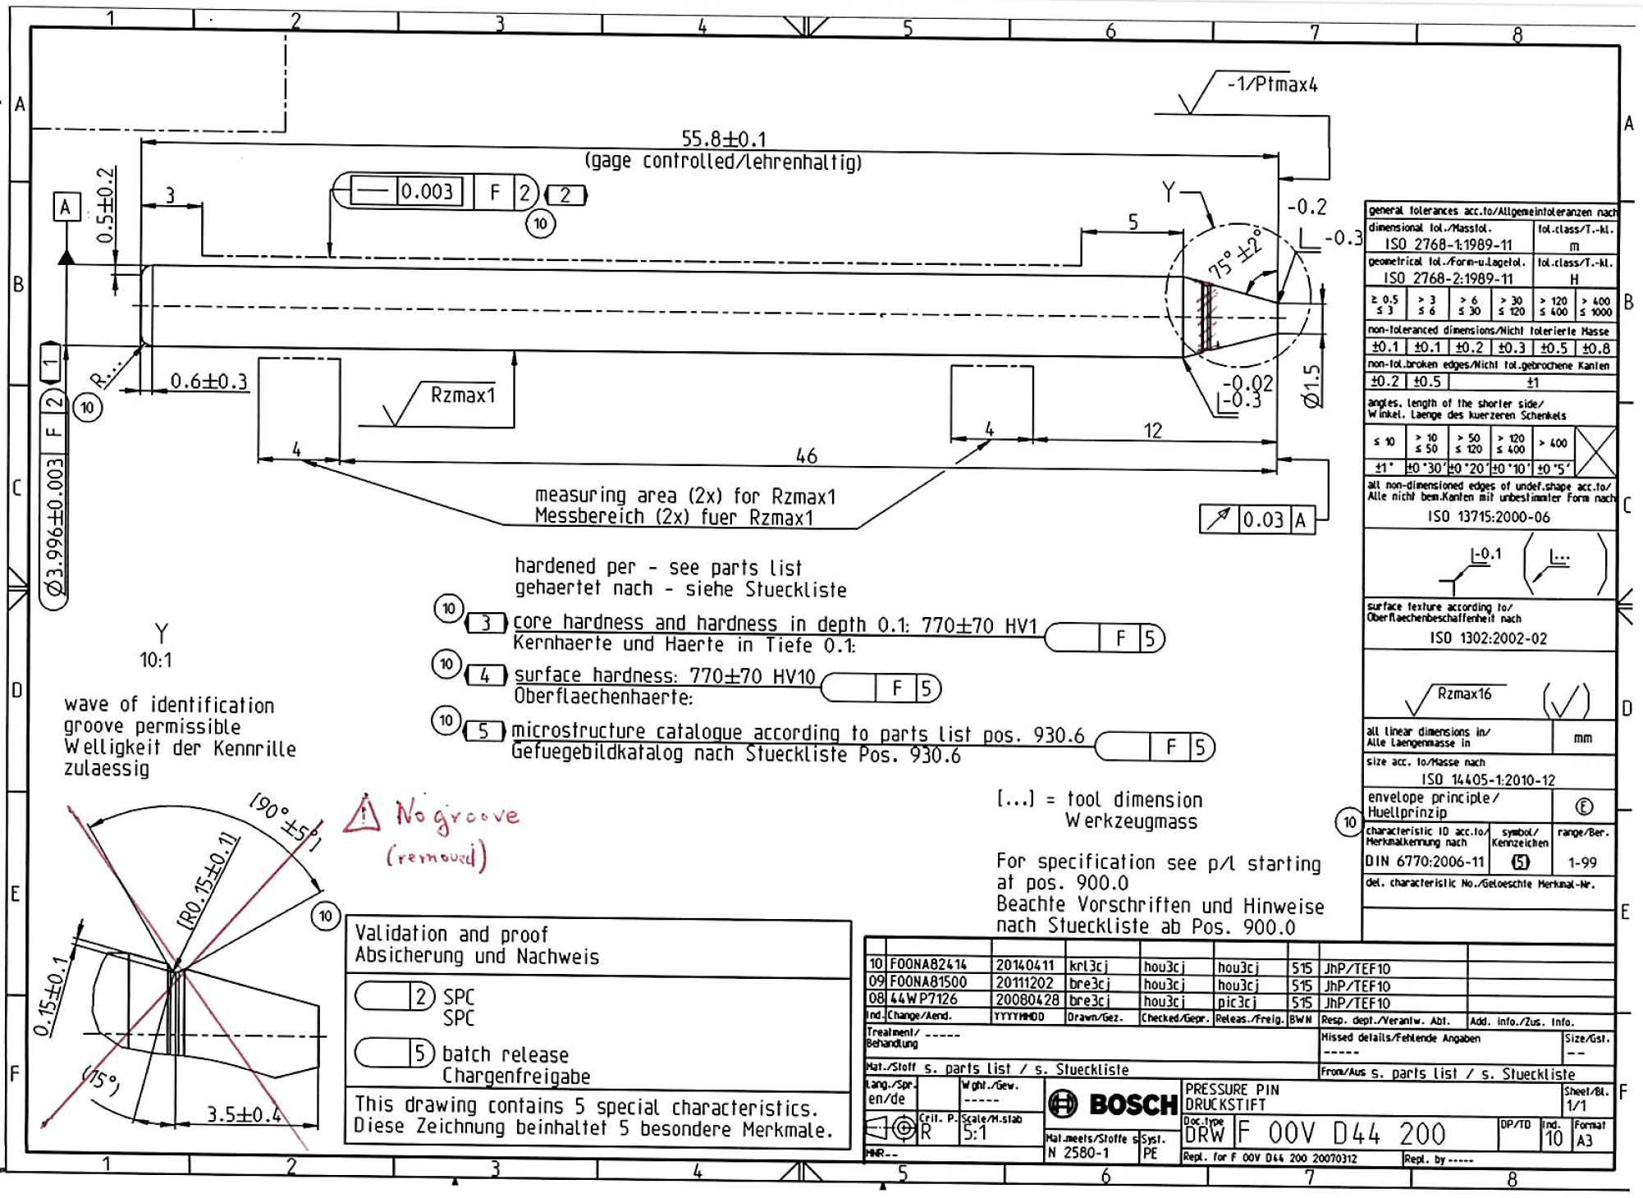
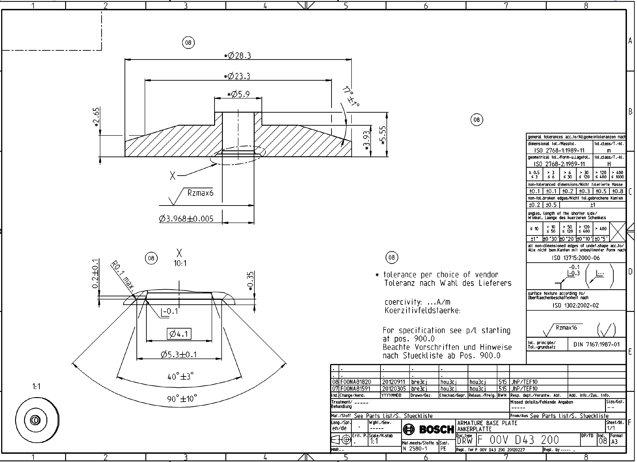
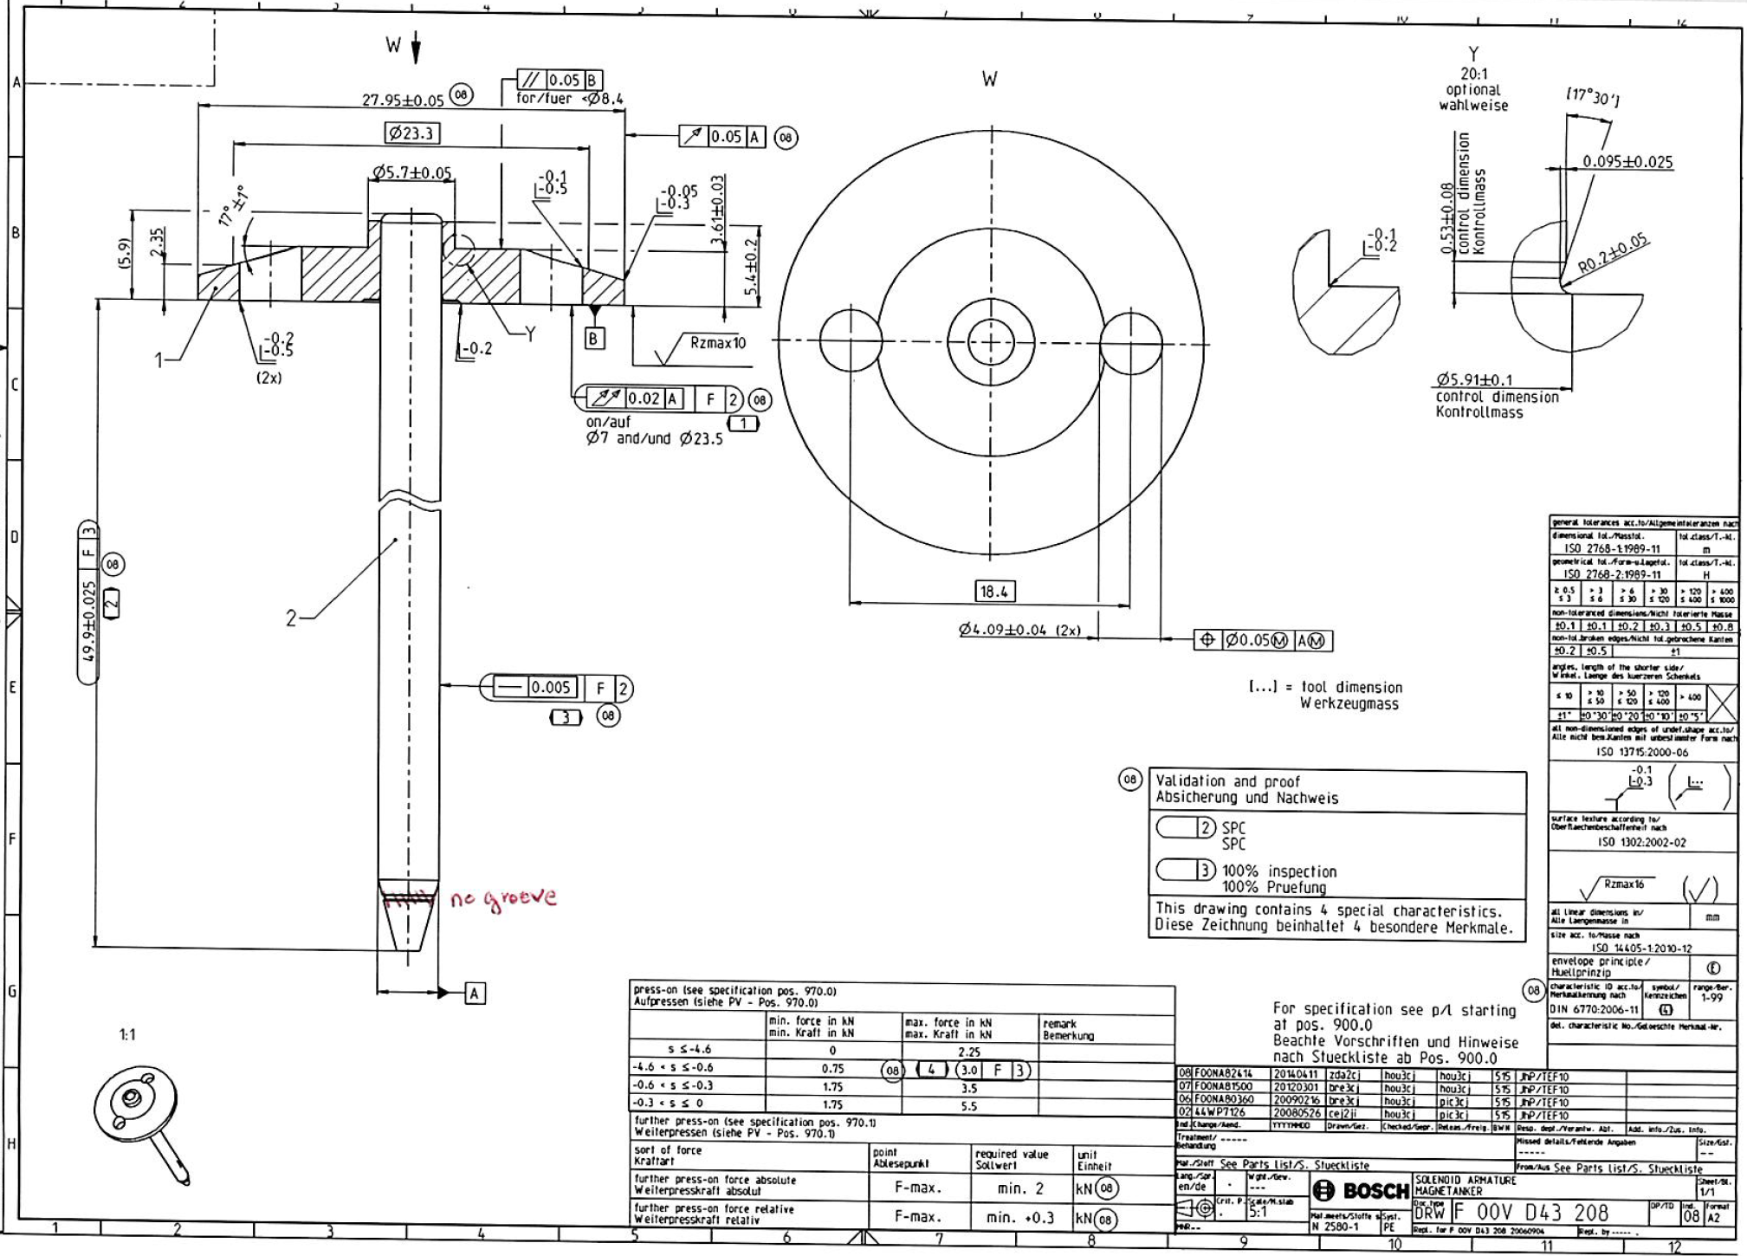
Products solenoid armature
Parts name | Assembled part reference | Plate reference | Pin reference
Solenoid armature | F 00N 000 182 | F 00V D43 207 Ø27,95mm, h5,4mm | F 00N 000 183 Ø4mm, L56,295mm
 | F 00N 000 375 | F 00N 000 274 Ø31,2mm, h6mm | F 00N 000 379 Ø5mm, L56,785mm
 | F 00V D43 203 | F 00V D43 200 Ø27,95mm, h5,4mm | F 00V D44 200 Ø4mm, L55,8mm
 | F 00V D43 208 | F 00V D43 207 Ø27,95mm, h5,4mm | F 00V D44 200 Ø4mm, L55,8mm
Cycle time: 8,2s
Basis of our offer:
Your specification ‚CDC solenoid armature assembly V1‘ from 02.04.2024
Your specification ‚CDC solenoid armature assembly V2.1‘ from 25.06.2024
Your process parameters F 00V D39 030 & F 00V D39 031
Phone call Brault/Bauguil on 07.06.2024
Former concept of M.Waas

Slide 3
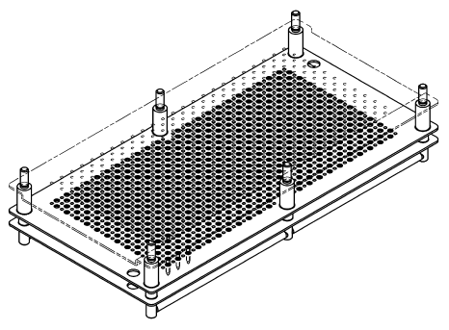
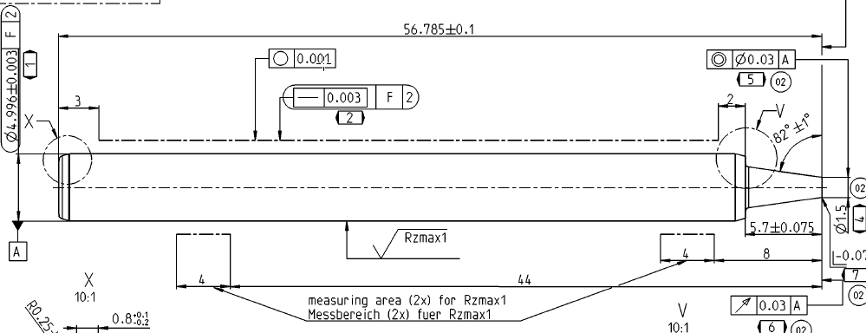
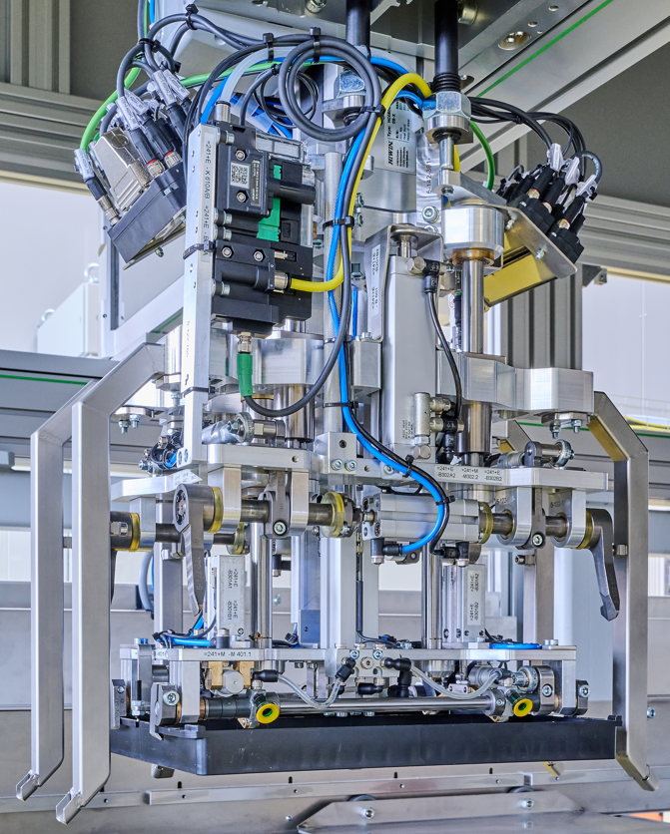
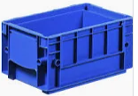
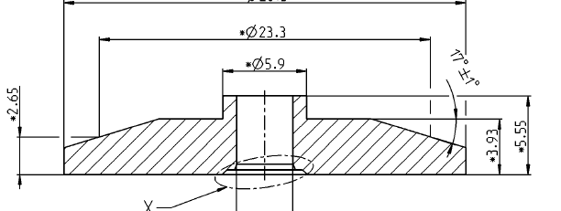
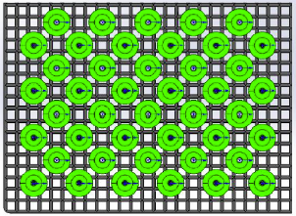
loading & unloading trays
Tray pin
ET_0746W004
two trays per class, three classes
alarm & light, if tray empty
changing empty tray doesn‘t stop the machine
Tray plate
To be defined
Tray solenoid armature
KLT 4280, Trays 6000.155.893
Tray aus plastic
44 parts, 329x238 mmm
Parts on the B-surface in tray
Ø3,9mm centering pin for all kind of plates
Poka Yoke on the right side
Compatible with conveyor
KLT 4280
Trays 6000.155.893
We don‘t have any information about your Tray
We assume that the tray can be automated and can be traded automatically in the KLT
We have experience with similar technology for Bosch Rexroth Elchingen
Picture shows the multifunctional gripper for Bosch Rexroth Elchingen
  Grip KLT
  Grip and handle “black palett” inside KLT
  Grip and place cover on KLT
  The gripper has a pneumatic spring system for
    Exact positioning on pallet-stack
    Emergency stop situation for potential collision

Slide 4
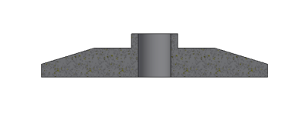
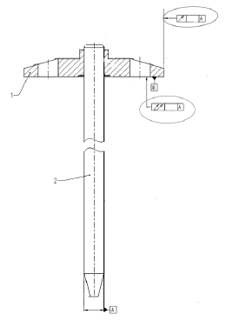
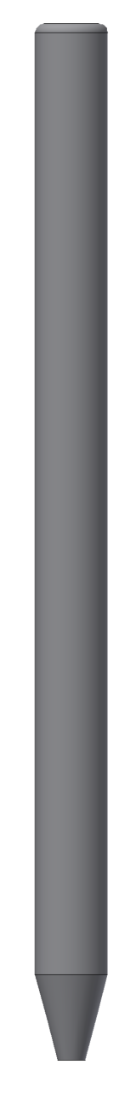
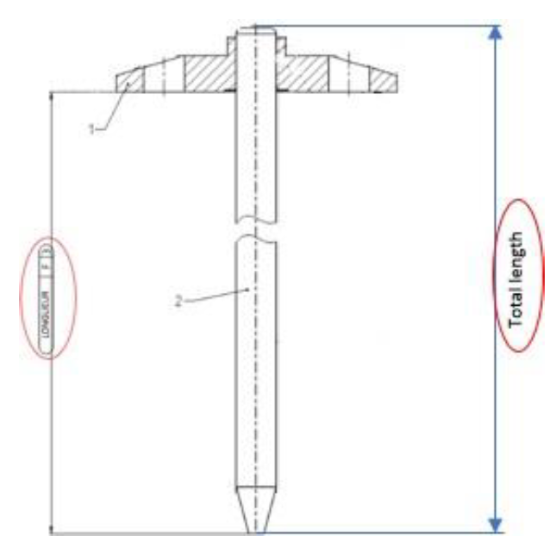
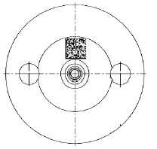
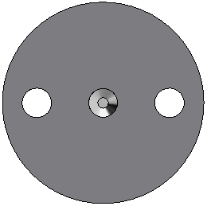
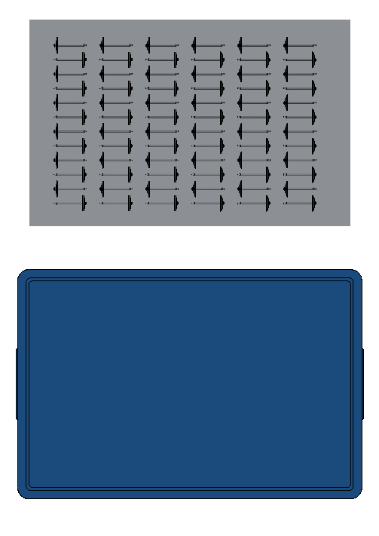
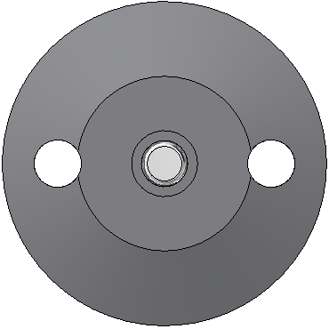
Required Processes V2.1
 | Processes
1 | feeding trays plate
2 | loading plate
3 | plate brushing
4 | hole plate measurement
5 | feeding trays pins
6 | selection needle, oiling & loading in assembly tool
7 | loading plate in assembly tool
8 | press fitting
9 | runout checking
10 | length checking
11 | back brushing
12 | DMC marking (option)
13 | DMC controlling (option) & AOI back
14 | AOI front
15 | AOI perimeter & pin tip
16 | free place
17 | cleaning solenoid armature (oil)
18 | cleaning solenoid armature (compressed air)
19 | unloading solenoid armature (iO & NiO)
20 | output trays solenoid armature
21 | output trays solenoid armature in KLTs
1
2
3
4
5
6
7
8
9
10
I
II
III
11
12
13
14
15
16
17
18
19
20
21
empty

Slide 5
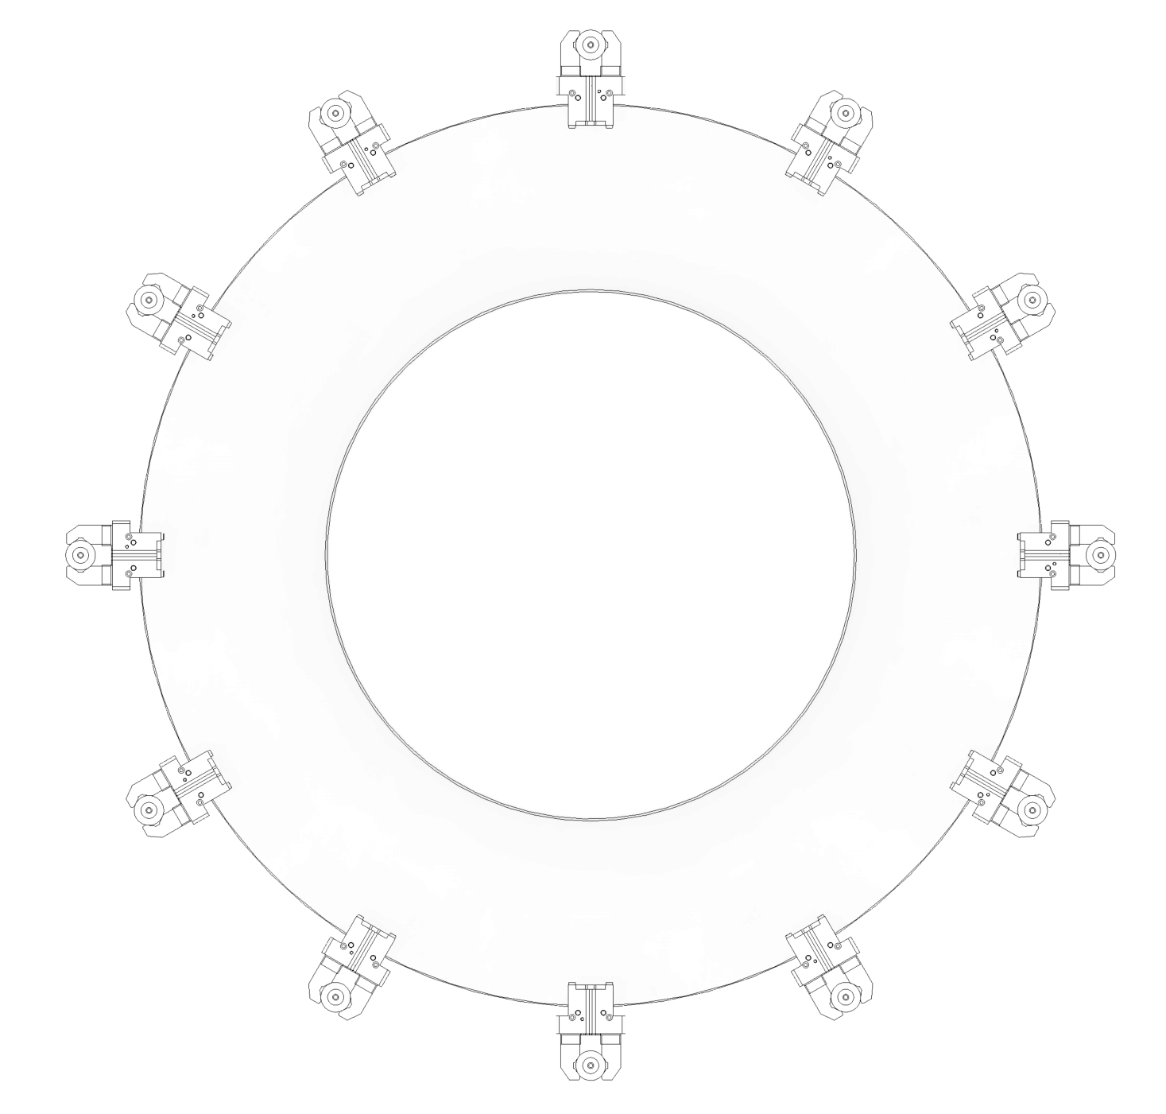
Transport unit (without options)
d
e
 | Positions round table
a | loading plate
b | plate brushing
c | hole plate measurement
d | oiling inner hole plate / measered value to handling pins
e | loading pin in assembly tool & press fitting
f | runout checking
g | length checking
h | back brushing
i | AOI back & front
j | AOI perimeter & pin tip
k | free place
l | unloading solenoid armature (iO & NiO)
c
f
b
g
a
h
l
i
k
j

Slide 6
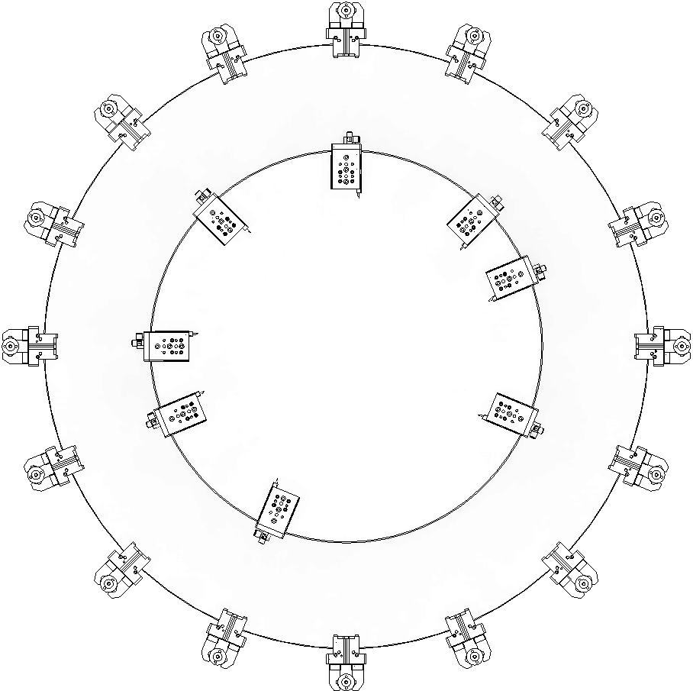
Transport unit (with options)
e
d
f
 | Positions round table
a | loading plate
b | plate brushing
c | hole plate measurement
d | oiling inner hole plate / measered value to handling pins
e | loading pin in assembly tool & press fitting
f | free place
g | runout checking
h | length checking
i | back brushing
j | angle orientation solenoid armature (option)
k | DMC marking (option)
l | DMC controlling (option)
m | AOI back & front
n | AOI perimeter & pin tip
o | free place
p | unloading solenoid armature
c
g
b
h
a
i
p
j
o
k
n
l
m

Slide 7
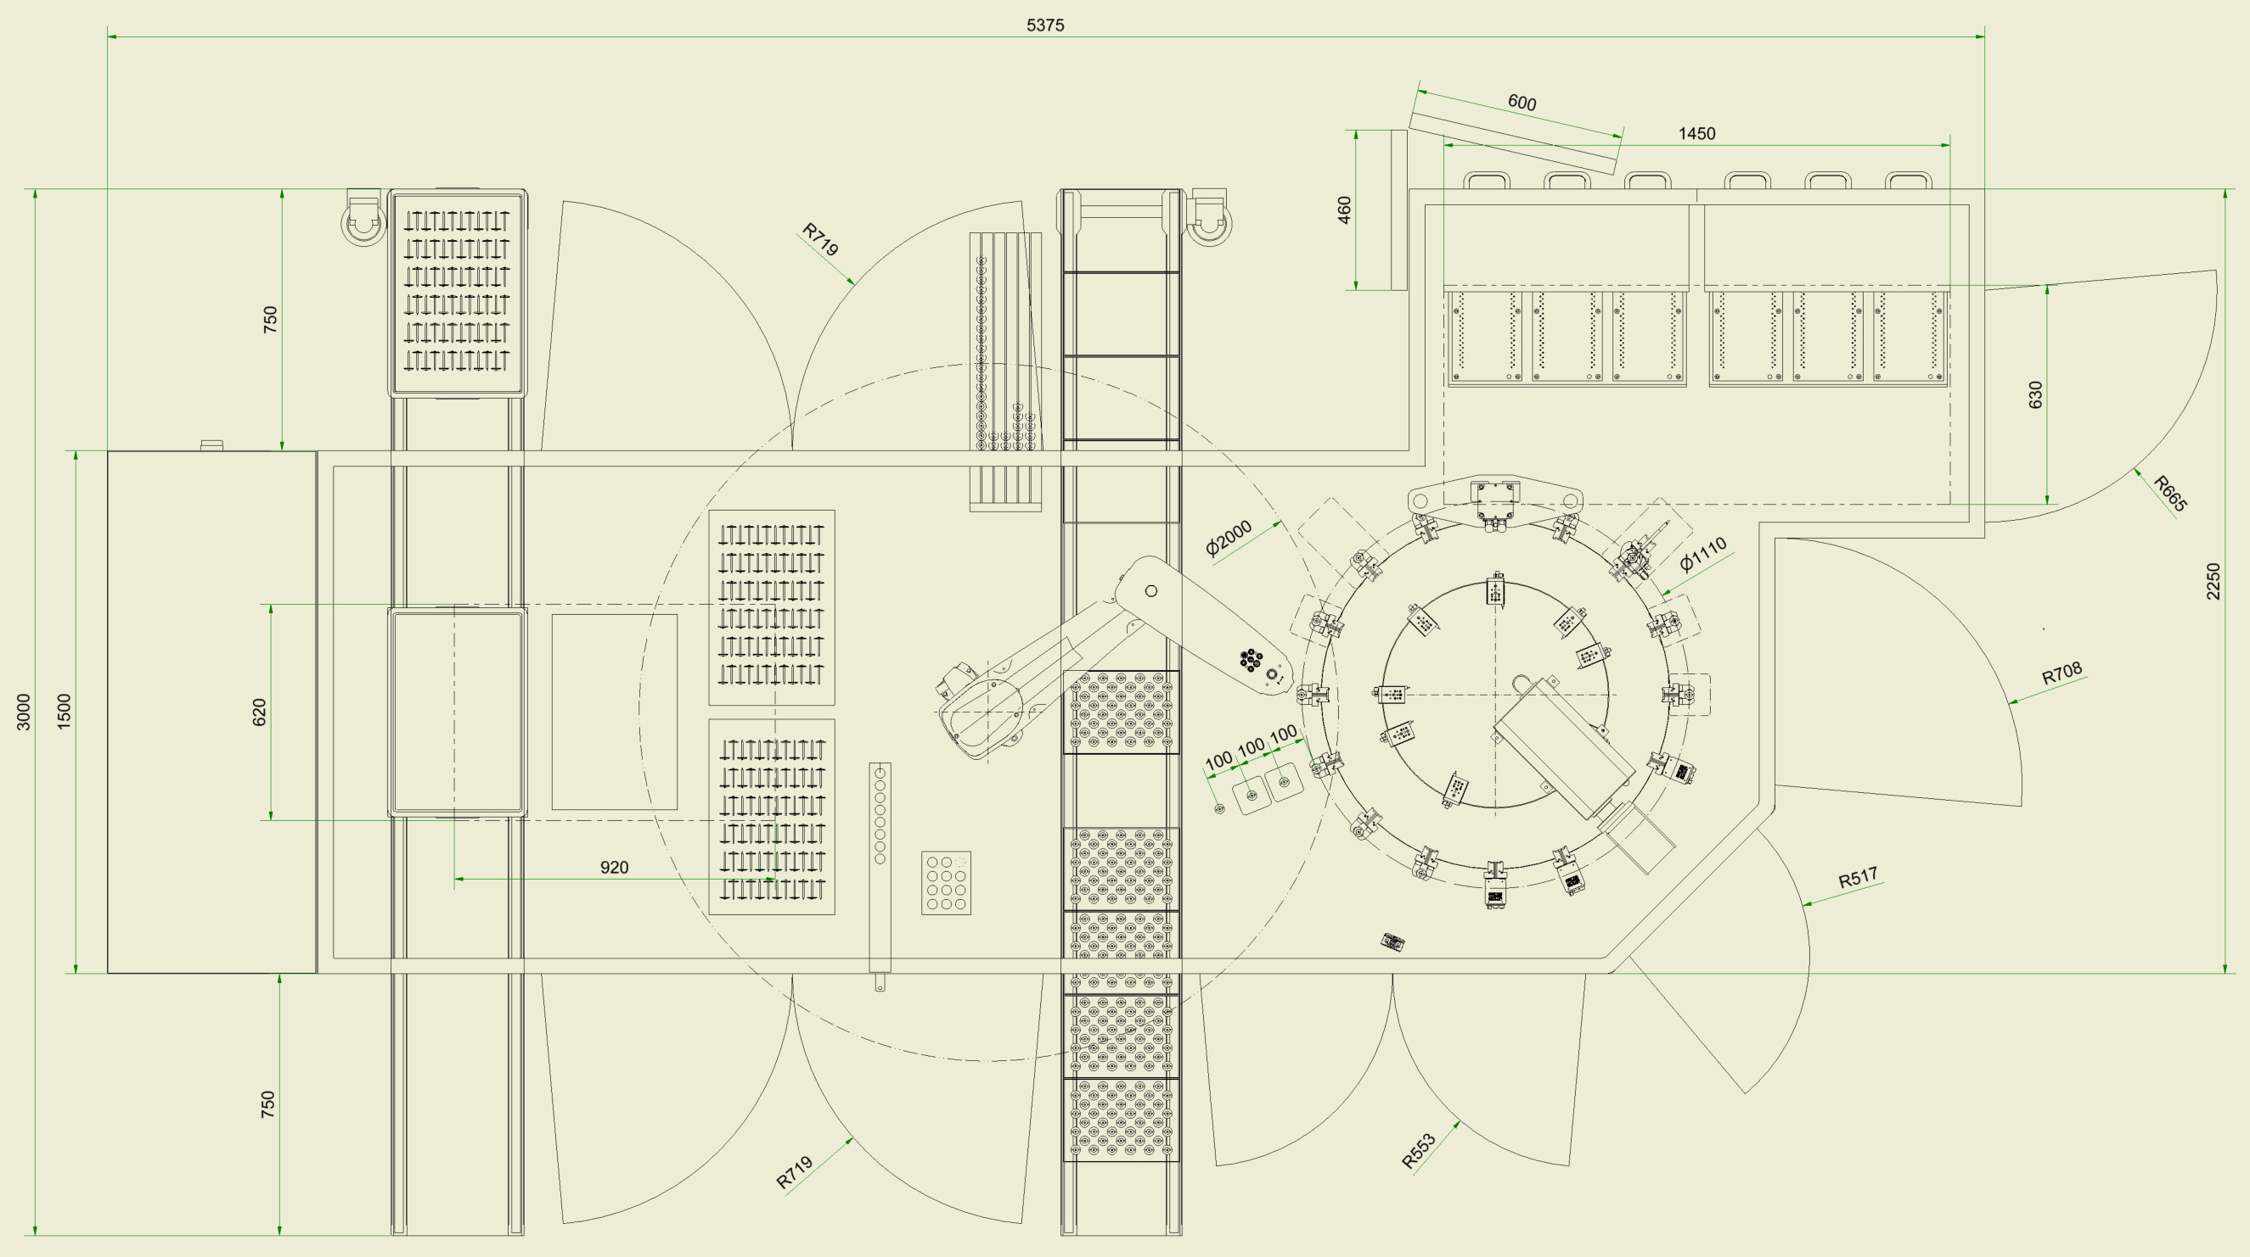
Layout
 | Stations
1 | feeding trays plate
2 | loading plate / unloading solenoid armature with Robot
3 | plate brushing
4 | hole plate measurement
5 | feeding trays pins with 6 drawers
6.1 | oiling inner hole plate / measured value to handling pins
6.2 | selection needle & loading in assembly tool
7/8 | loading plate in assembly tool & press fitting
9 | runout checking
10 | length checking
11 | back brushing
12 | angle orientation part for DMC marking (option)
13 | DMC marking (option)
14 | DMC controlling (option)
15 | Possible position for „AOI back & front“
16 | Possible position for „AOI perimeter & pin tip“
17 | free place
18 | handling solenoid armature with oiling/cleaning station
19 | buffer pile empty trays solenoid armature
20 | loading solenoid armatures in tray, 2x
21 | handling trays solenoid armature
22 | output KLTs with trays solenoid armature
23 | transport unit / Round table
24 | output NiO-Parts
25 | drawer SPC-Parts
26 | stabi-parts
27 | base frame
28 | controls & electrics
29 | pneumatics
22
5
24
27
6.2
28
4
6.1
9
21
3
7/8
10
19
20
2
23
11
12
26
18
17
13
25
16
15
14
1

Slide 8
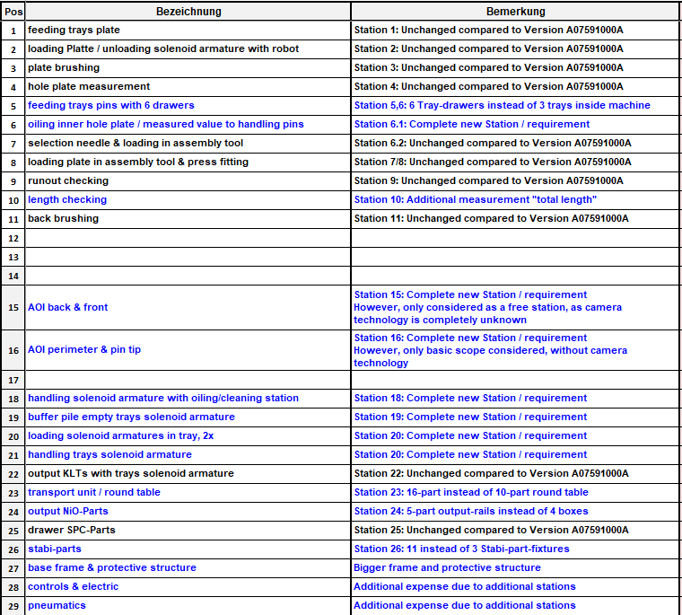
Differences to first offer A0759100A due to new RzP-requirements
12,13,14: Option DMC-Marking
DMC-Marking: 16-part round table required

Slide 9
Comments / Notes
Station 13: Marking laser
Warranty on the laser vmc3-class4 with special conditions between Bosch & Trumpf will stop at the end of 2025.
No more Trumpf support or spare parts available after this date!
Station 4: Hole plate measurement
Complete measurement equipment Plate-Inner-Ø (Stotz, measurement devices, pneumatics,…) incl. BCI-OpConPlus-Object is Bosch provision
Station 6: Oiling inner hole plate
We recommend the oiling of the inner hole plate instead of oiling the pin
Station 15: AOI back & front
Station 16: AOI perimeter & pin
Based on your shown „error patterns“ (your document „Visual inspection defect.pdf“) it is not possible to define the requiered camera-equipment
Bosch feasibility study is requiered for definition the complete camera/lighting technology
Without this information we cannot design / calculate this both stations
That‘s why we only have on 2 empty stations available
The complete 2 Stations (Camera- and Station- Hardware, complete engineering and so on) are not calculated
Station 16: AOI perimeter & pin
Identical to Station 15
Station 18: Handling solenoid armature with oiling / cleaning station
A „Pilgrim step handling“ position the parts
  from Round table to Pos-1 „Oiling / cleaning station“
  from Pos-1 to Pos-2 „Blow off station“
  from Pos-2 to Pos-3 „Pick up part by Robot“
We cannot guarantee that the cleanliness of the parts (required in the specifications) is guaranteed by the simple oiling process
OpConPlus Objects
We assume that all required OpConPlus objects exist. If this is not the case, the commissioning of a new OpConPlus object is not within the scope of our offer

Slide 10
Price indication
Total price:
Complete machine: 1.490.000€
Without option
Including re-commissioning in Rodez
Option DMC-Marking: 108.000€
Including
  16-fold round table instead of 12 fold-round table, incl. 4 additional clamping units and 1 additional opening unit
  (additional expenditure compared to first offer-version)
  Angle Orientation before DMC-Marking
  DMC-Marking
  Control DMC
Bosch provisions are:
  Complete Trumpf laser for DMC-marking incl. OpConPlus-Object
  Complete Cognex camera equipment for Angle Orientation
  Complete Cognex camera equipment for Control

Slide 11
Danke
für die Aufmerksamkeit

